Slide 1
Linear Regression
A number of slides and screenshots from : Andrew Ng’s course on machine learning and Sebastian Raschka’s course on deep learning
Both can be found for free on youtube

Slide 2
What does regression mean ?
Seen in intro, but :
Regression means predictiong real-valued outputs.
An essential type of supervised machine learning task (trying to give the right « answer » for each example in the data).
Often contrasted with classification.
Example :
Predicting height => many many real-valued outputs are possible…
Vs. Predicting a « height class » : short medium-height tall

Slide 3
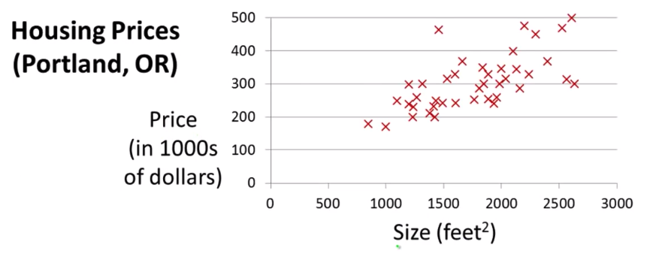
Dataset and problem example
Imagine we want to create an ML algorithm to predict the price of a house, using only as information the size of the house. This is the dataset we can use to train our algorithm.

Slide 4
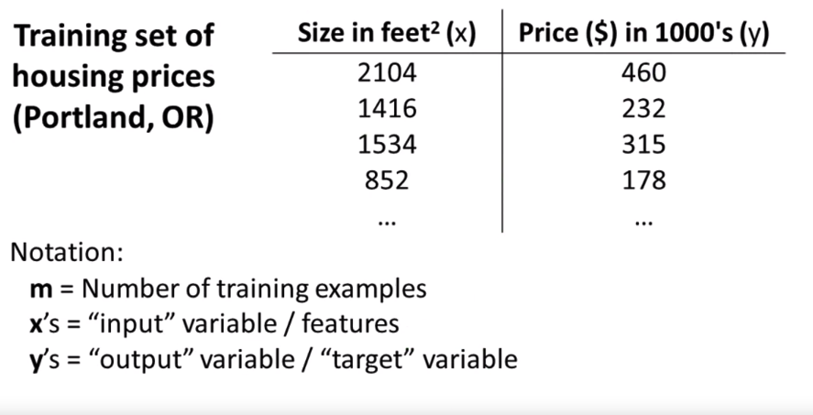
Training Set and Notation

Slide 5
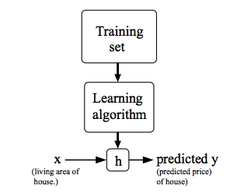
The supervised learning workflow
h: hypothesis
h is a function which maps x’s to y’s
Our goal will be to find the function which takes
x as input and predicts the correct y for that
x.

Slide 6
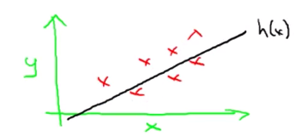
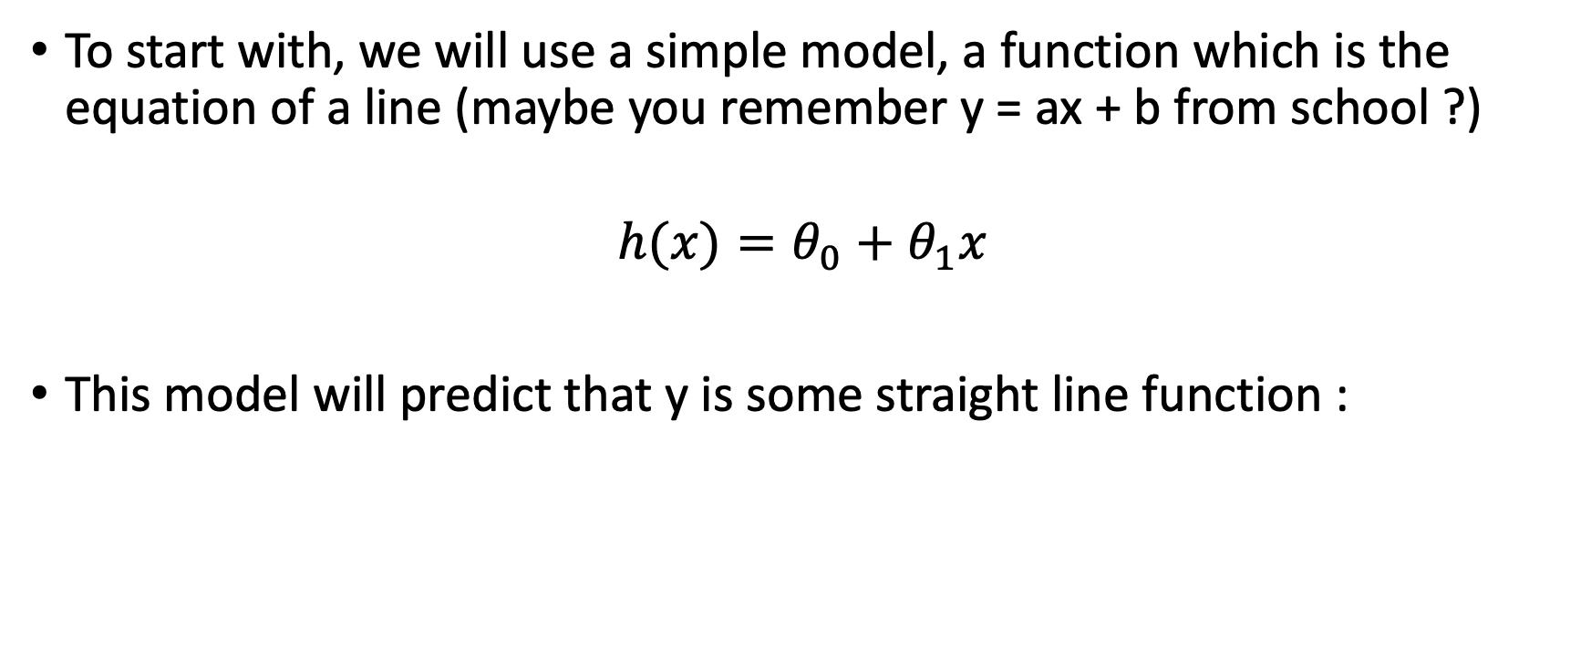
Model h
To start with, we will use a simple model, a function which is the equation of a line (maybe you remember y = ax + b from school ?)
$$h(x)=θ_{0}+θ_{1}x$$
This model will predict that y is some straight line function :

Slide 7
If this seems a bit odd to you…
Remember we want our function to predict the examples we have in our training set correctly,
which our simple model will probably not do very well….
What if we can’t get to all the points using a straight line ?
Don’t worry for now, this is still a good starting point !

Slide 8
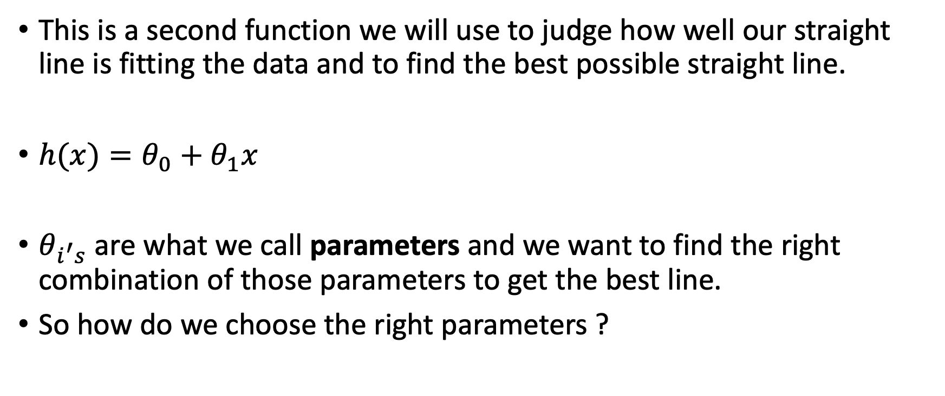
Cost function
This is a second function we will use to judge how well our straight line is fitting the data and to find the best possible straight line.
$h(x)=θ_{0}+θ_{1}x$
$θ_{i^{′}s}$ are what we call parameters and we want to find the right combination of those parameters to get the best line.
So how do we choose the right parameters ?

Slide 9
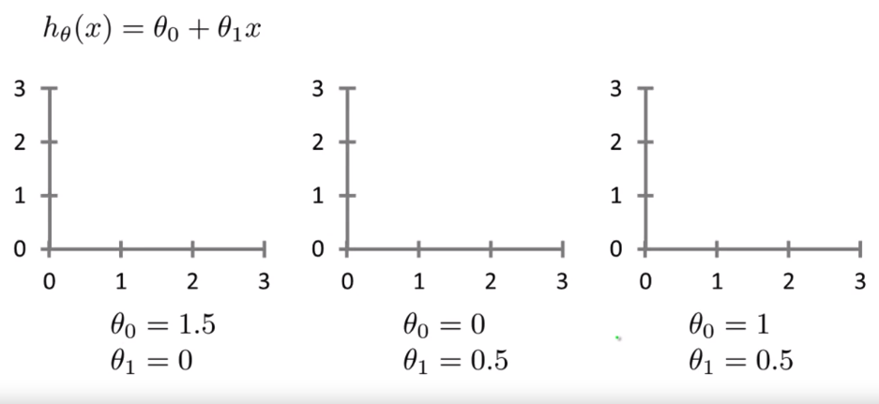
Different parameter choices/hypotheses

Slide 10
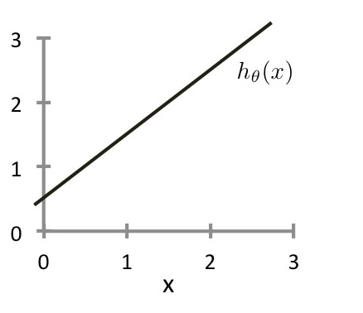
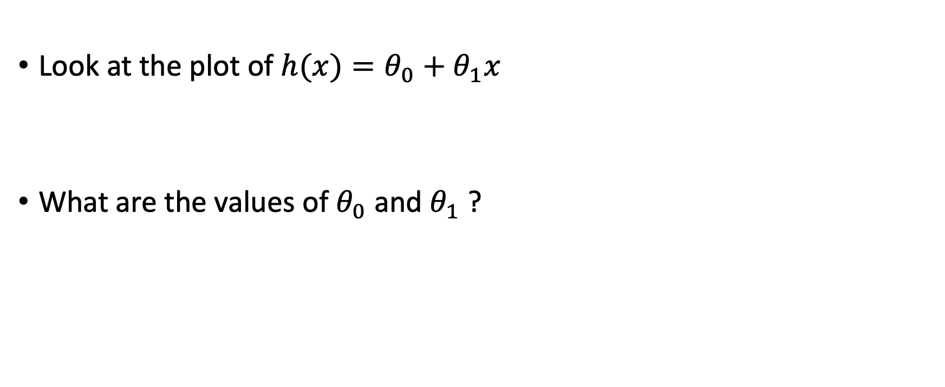
Exercise
Look at the plot of $h(x)=θ_{0}+θ_{1}x$
What are the values of $θ_{0}$ and $θ_{1}$ ?

Slide 11
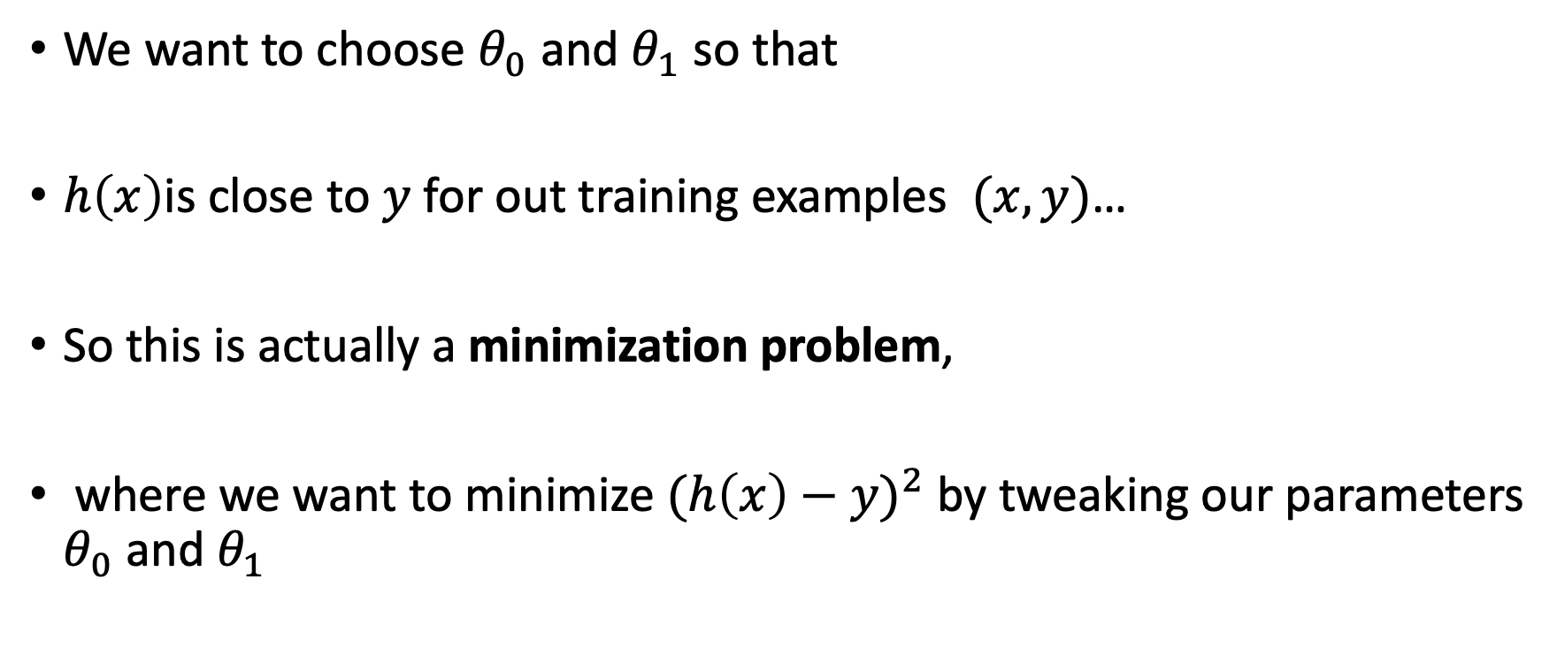
Minimization Problem
We want to choose $θ_{0}$ and $θ_{1}$ so that
$h\left(x\right)$is close to $y$ for out training examples $(x, y)$…
So this is actually a minimization problem,
where we want to minimize ${(h\left(x\right)−y)}^{2}$by tweaking our parameters $θ_{0}$ and $θ_{1}$

Slide 12
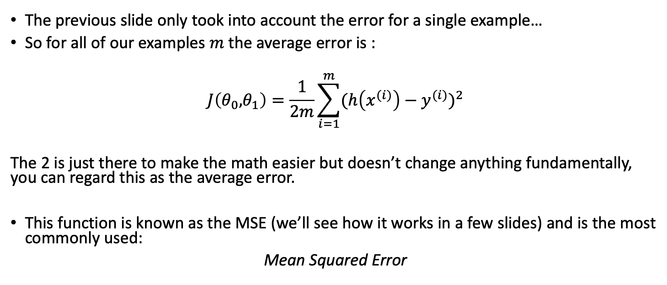
Cost function = Quantifying the model’s error
The previous slide only took into account the error for a single example…
So for all of our examples $m$ the average error is :
$$J\left(θ_{0}\text{,}θ_{1}\right)=\frac{1}{2m}\sum_{i=1}^{m}{{(h\left(x^{(i)}\right)−y^{(i)})}^{2}}$$
The 2 is just there to make the math easier but doesn’t change anything fundamentally, you can regard this as the average error.
This function is known as the MSE (we’ll see how it works in a few slides) and is the most commonly used:
Mean Squared Error

Slide 13
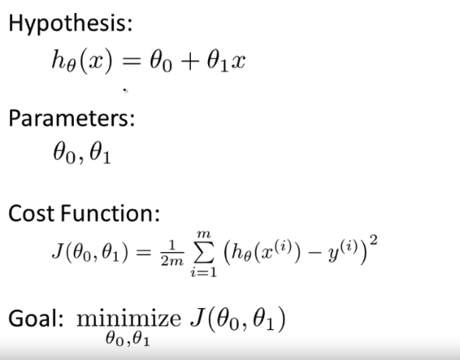
To recap
https://www.coursera.org/learn/machine-learning/home/welcome

Slide 14
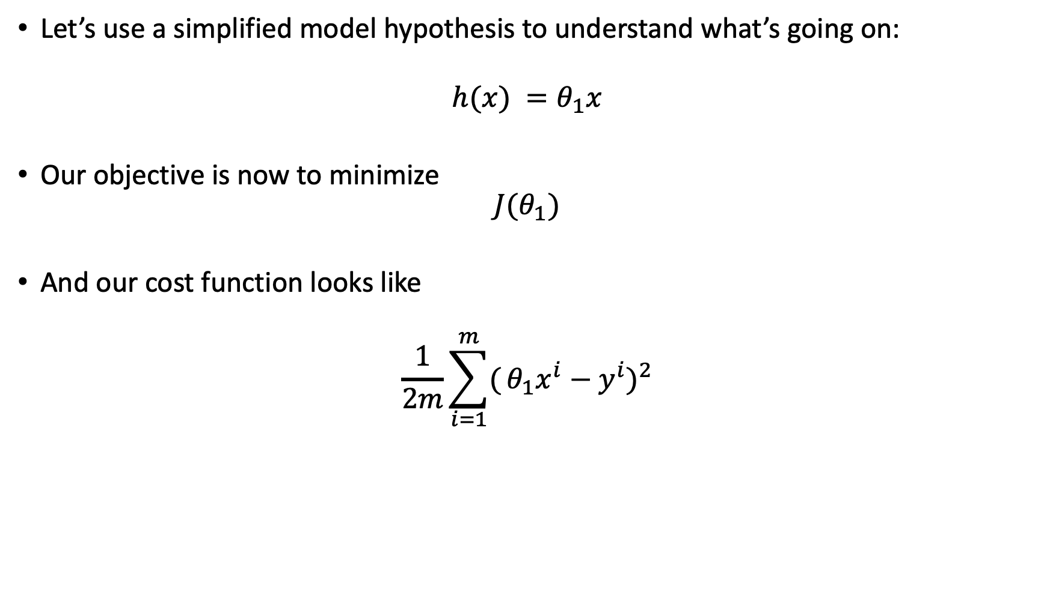
Cost Function Intuition
Let’s use a simplified model hypothesis to understand what’s going on:
$$h(x) =θ_{1}x$$
Our objective is now to minimize
$$J(θ_{1})$$
And our cost function looks like
$$\frac{1}{2m}\sum_{i=1}^{m}{(}{θ_{1}x^{i}−y^{i})}^{2}$$

Slide 15
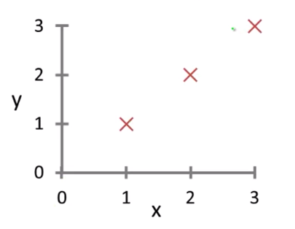
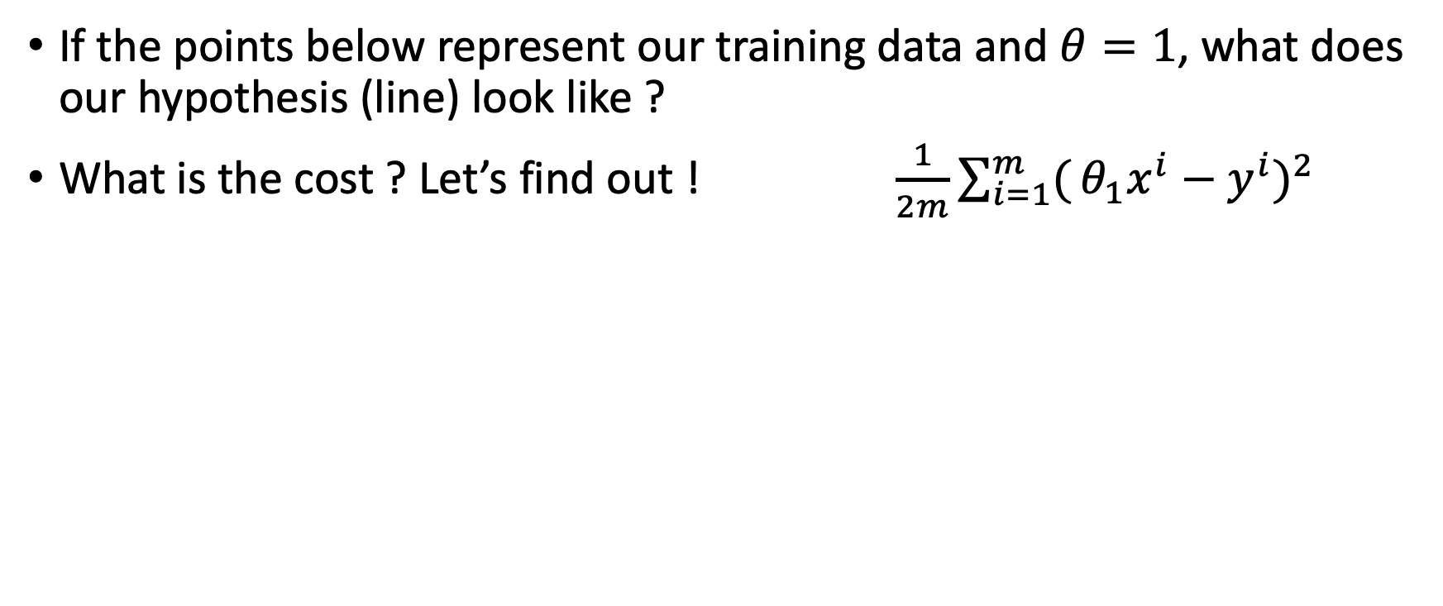
Hypothesis function vs. Cost function
If the points below represent our training data and $θ=1$, what does our hypothesis (line) look like ?
What is the cost ? Let’s find out ! $\frac{1}{2m}\sum_{i=1}^{m}{(}{θ_{1}x^{i}−y^{i})}^{2}$

Slide 16
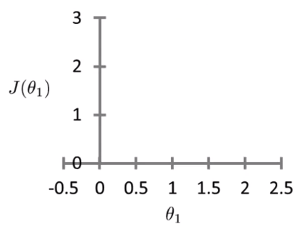
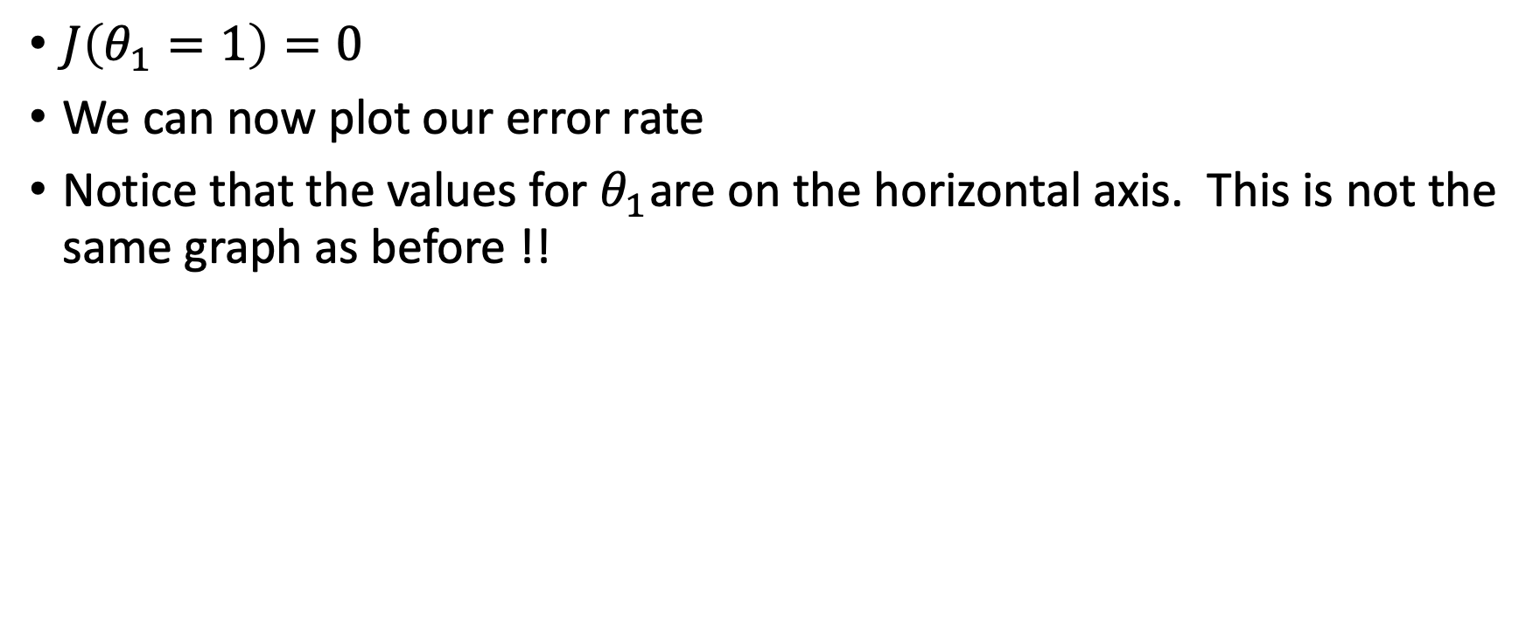
Hypothesis function vs. Cost function
$J\left(θ_{1}=1\right)=0$
We can now plot our error rate
Notice that the values for $θ_{1}$are on the horizontal axis. This is not the same graph as before !!

Slide 17
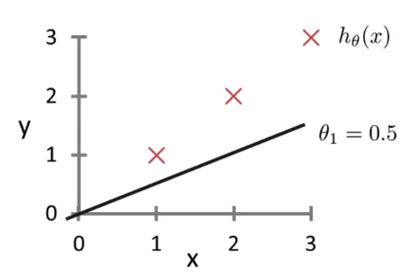
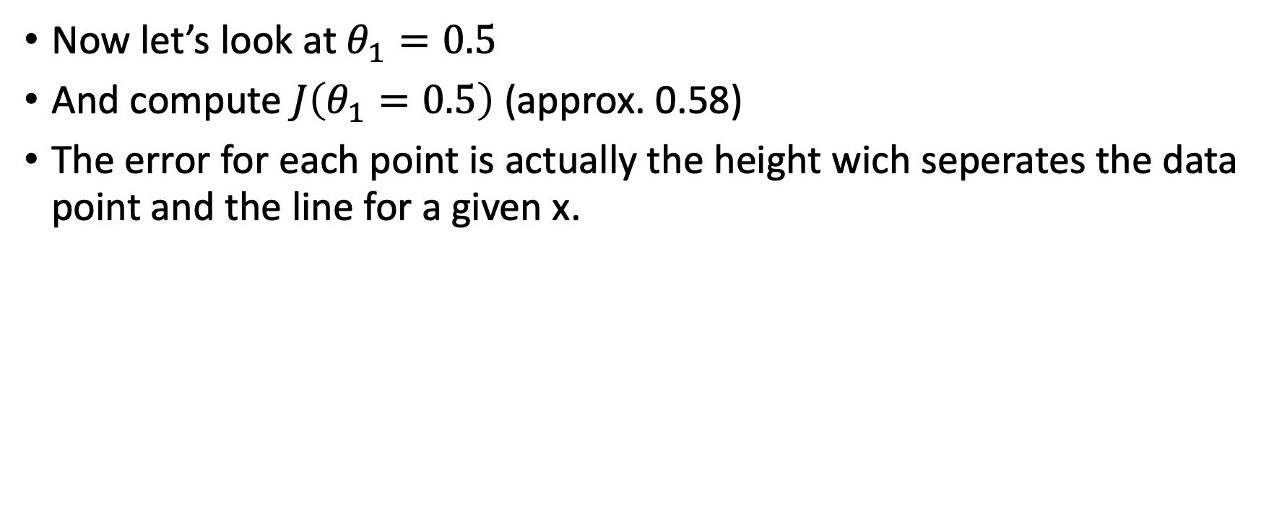
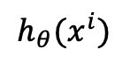
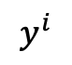
Hypothesis function vs. Cost function
Now let’s look at $θ_{1}=0.5$
And compute $J\left(θ_{1}=0.5\right)$ (approx. 0.58)
The error for each point is actually the height wich seperates the data point and the line for a given x.
$$y^{i}$$
$$h_{θ}(x^{i})$$

Slide 18
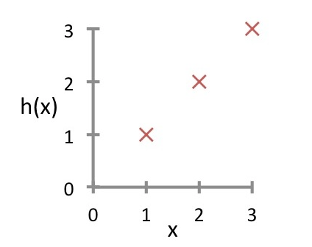
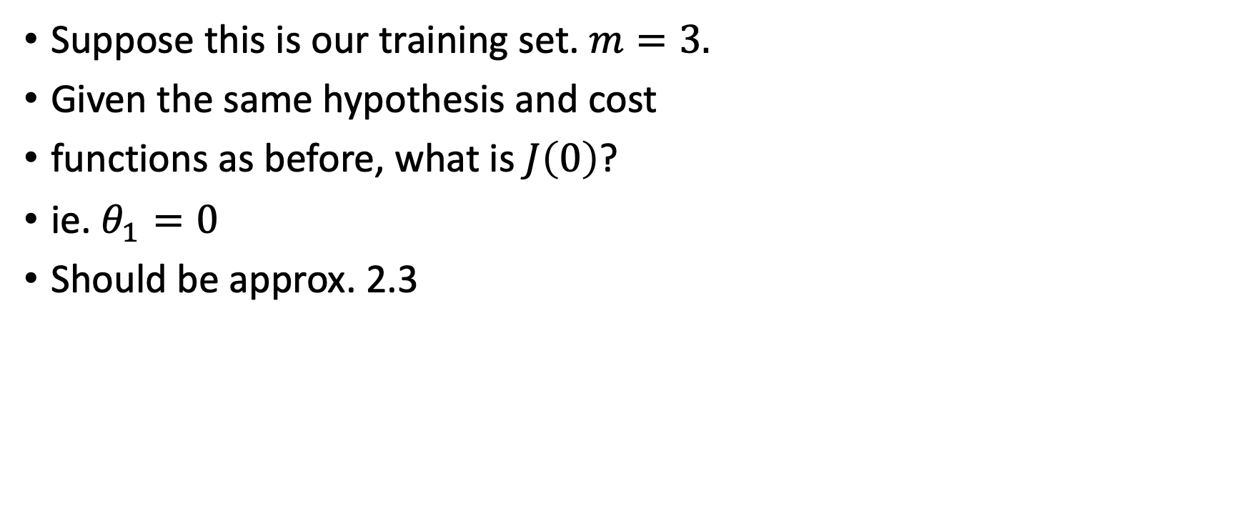
Your turn !
Suppose this is our training set. $m=3.$
Given the same hypothesis and cost
functions as before, what is $J\left(0\right)$?
ie. $θ_{1}=0$
Should be approx. 2.3

Slide 19
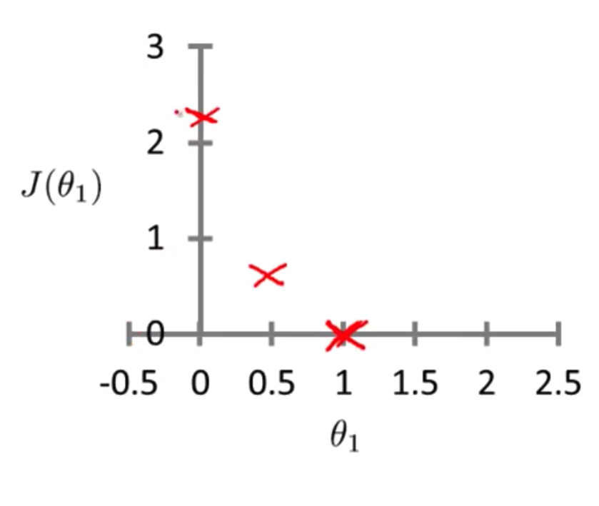
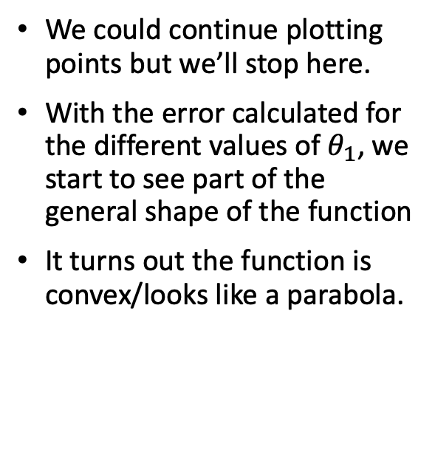
Hypothesis function vs. Cost function
We could continue plotting points but we’ll stop here.
With the error calculated for the different values of $θ_{1}$, we start to see part of the general shape of the function
It turns out the function is convex/looks like a parabola.

Slide 20
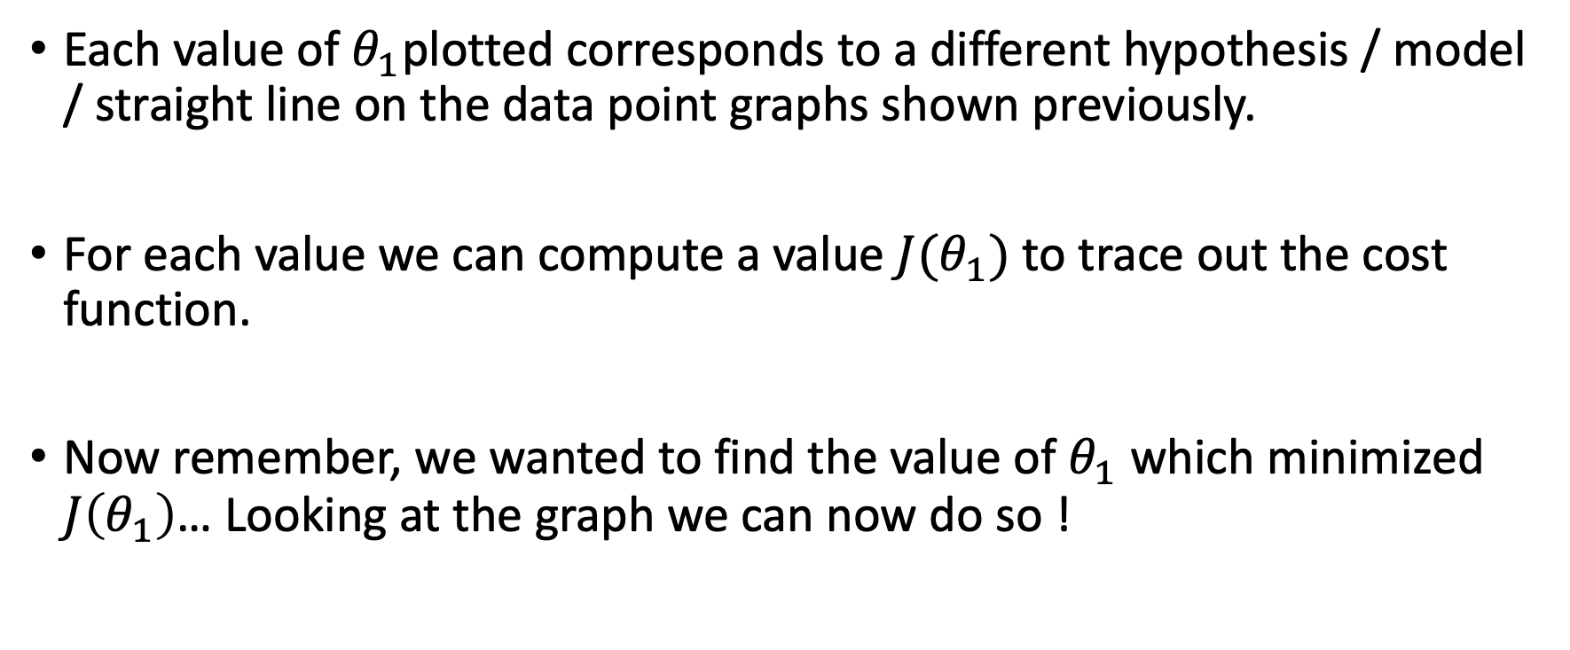
Quick recap
Each value of $θ_{1}$plotted corresponds to a different hypothesis / model / straight line on the data point graphs shown previously.
For each value we can compute a value $J(θ_{1})$ to trace out the cost function.
Now remember, we wanted to find the value of $θ_{1}$ which minimized $J\left(θ_{1}\right)$… Looking at the graph we can now do so !

Slide 21
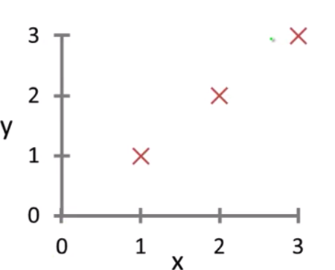
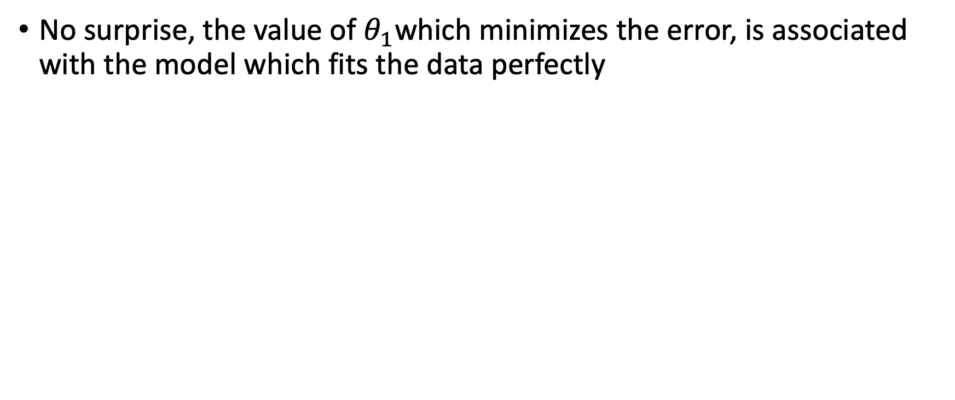
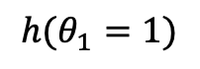
No surprise, the value of $θ_{1}$which minimizes the error, is associated with the model which fits the data perfectly
$$h(θ_{1}=1)$$

Slide 22
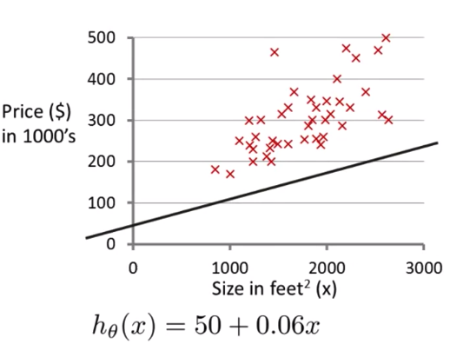
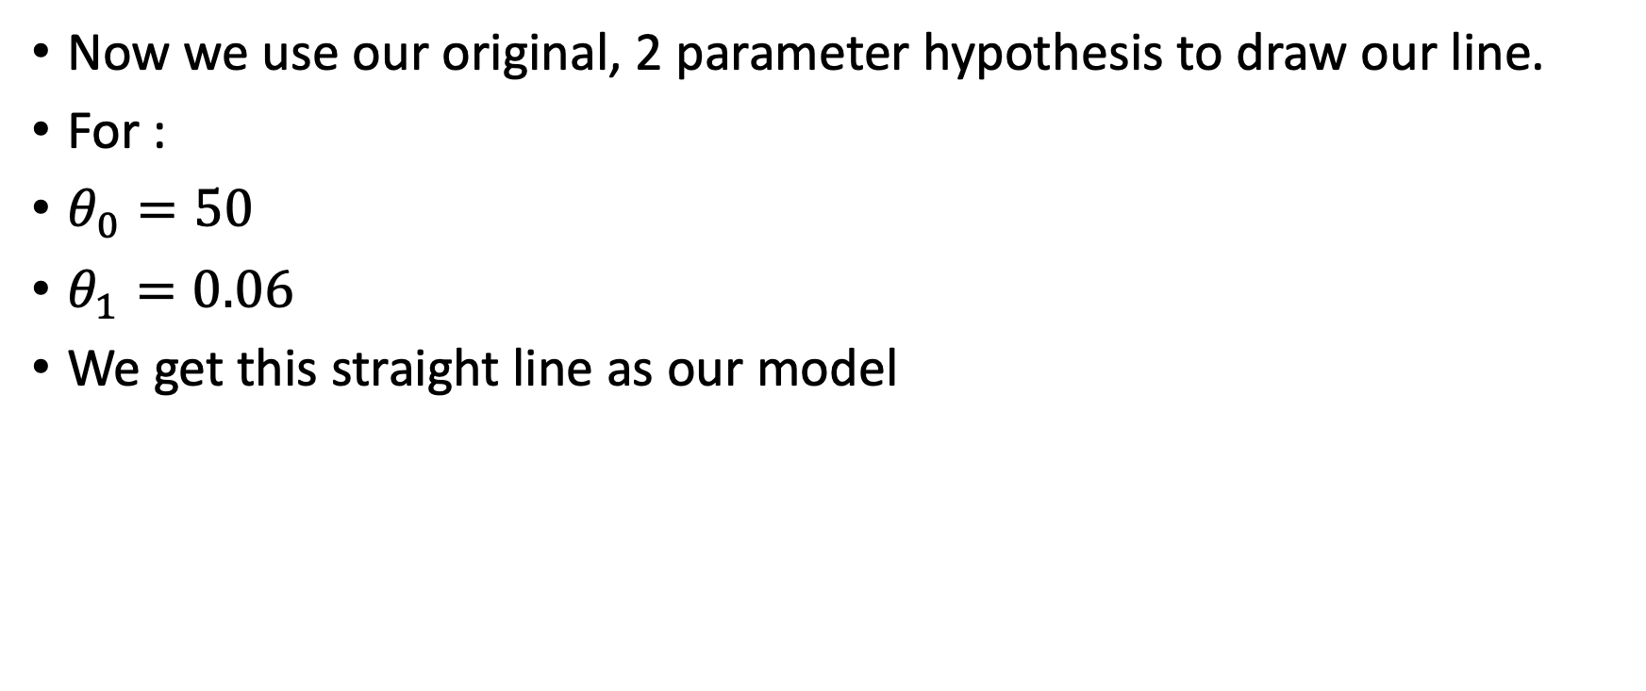
Back to 2 parameters
Now we use our original, 2 parameter hypothesis to draw our line.
For :
$θ_{0}=50$
$θ_{1}=0.06$
We get this straight line as our model

Slide 23
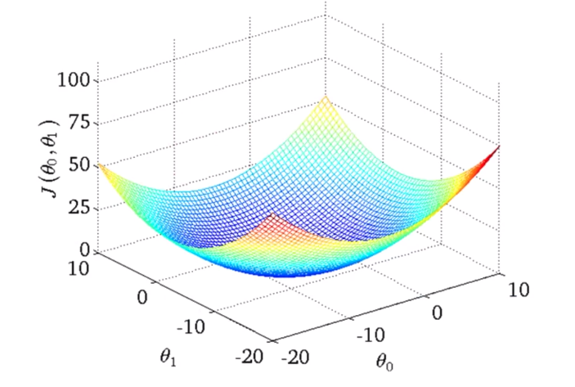
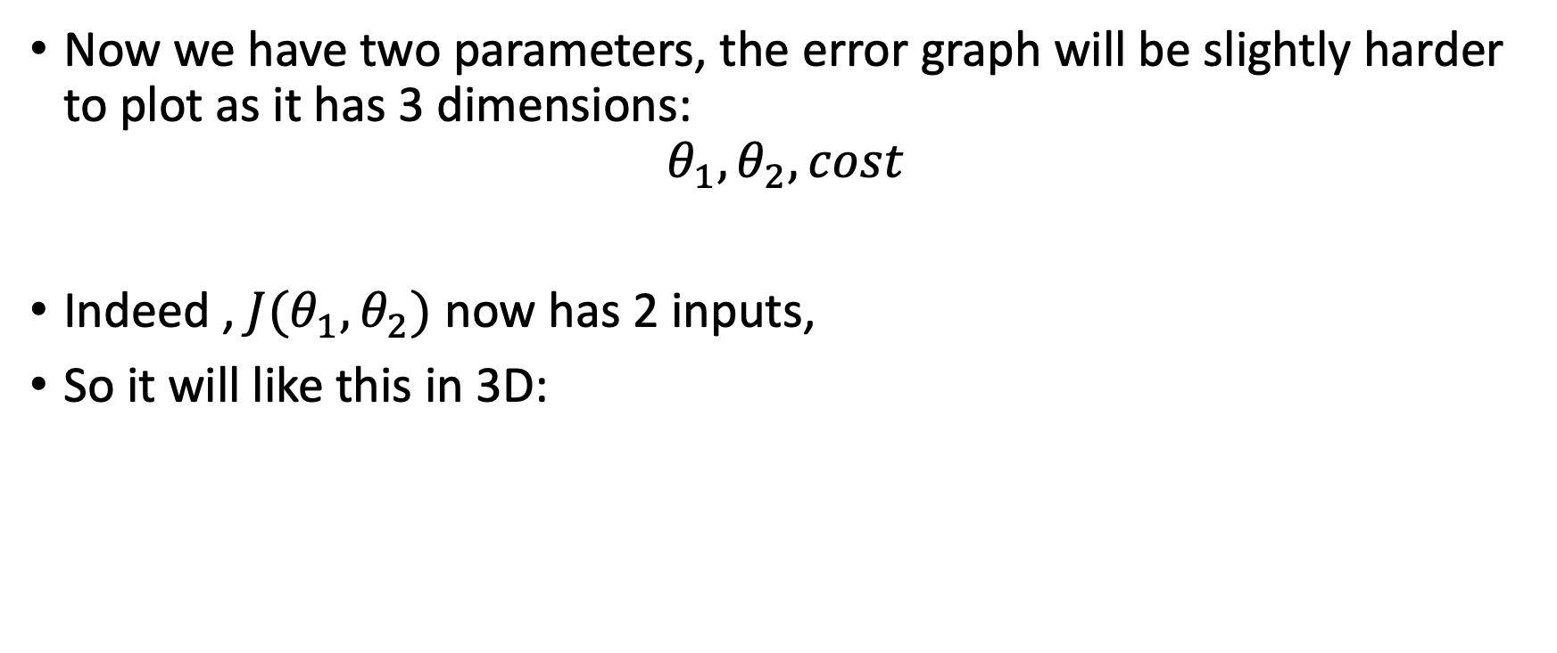
Corresponding Cost function
Now we have two parameters, the error graph will be slightly harder to plot as it has 3 dimensions:
$$θ_{1}, θ_{2}, cost$$
Indeed , $J(θ_{1},θ_{2})$ now has 2 inputs,
So it will like this in 3D:

Slide 24
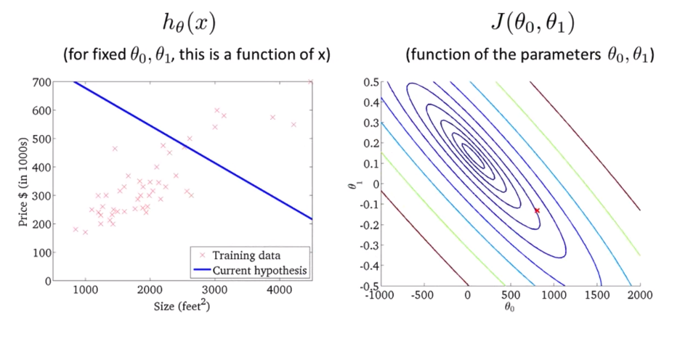
Contour Plots
To stay in 2D, you will see the cost function represented by a contour plot :
The ovals/ellipses show the set of points which take on the same value for given values of $θ_{0}, θ_{1}$

Slide 25
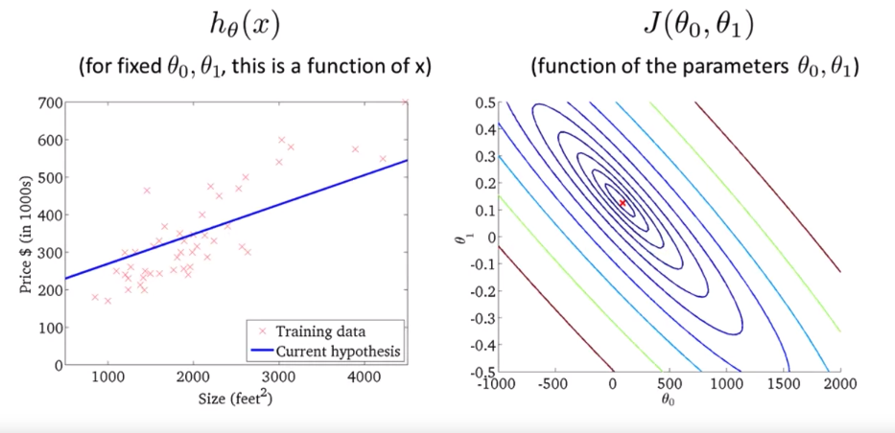
Countour Plots
The minimum is at the center of all the « ellipses ».
This shows a model very close to the minimum.

Slide 26
Gradient Descent
Now we know how to evaluate a model, using a cost function, how do we make the model learn the optimal parameters ?
In other words, how do we minimize the cost function without testing all the different possible models ?
The algorithm used to do this is called Gradient Descent, and is essential to most machine learning algorithms, not just linear regression !

Slide 27
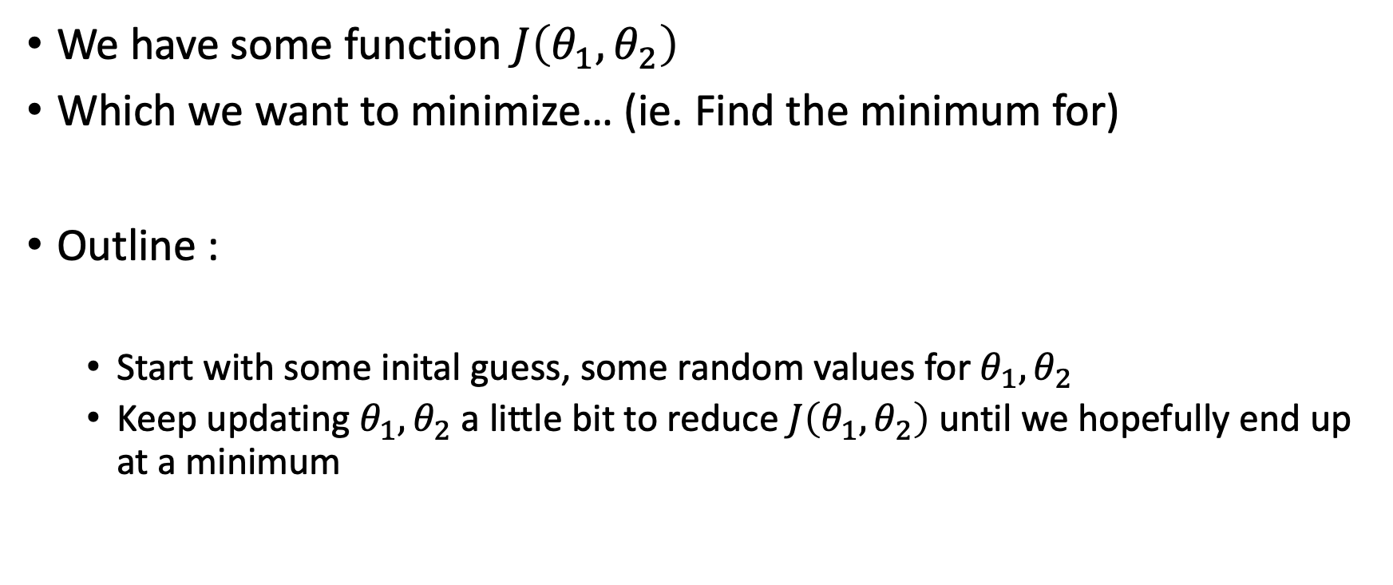
Gradient Descent
We have some function $J\left(θ_{1},θ_{2}\right)$
Which we want to minimize… (ie. Find the minimum for)
Outline :
Start with some inital guess, some random values for $θ_{1},θ_{2}$
Keep updating $θ_{1},θ_{2}$ a little bit to reduce $J\left(θ_{1},θ_{2}\right)$until we hopefully end up at a minimum

Slide 28
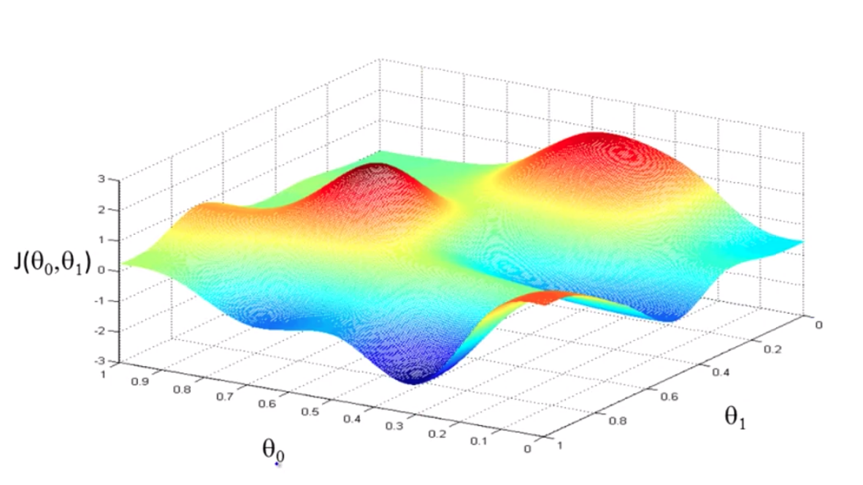

GD intuition
This is your cost function in 3D
Imagine you start somewhere near the top of one of the « hills » and your goal is to walk in the direction which will take you down to the bottom the fastest.

Slide 29
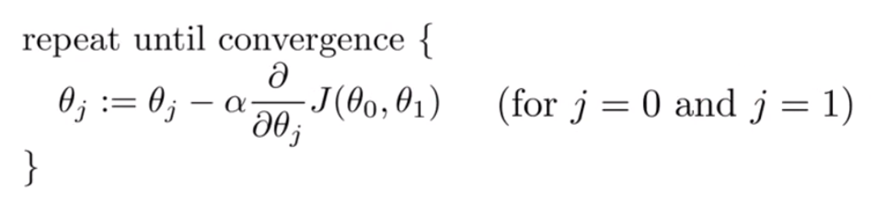
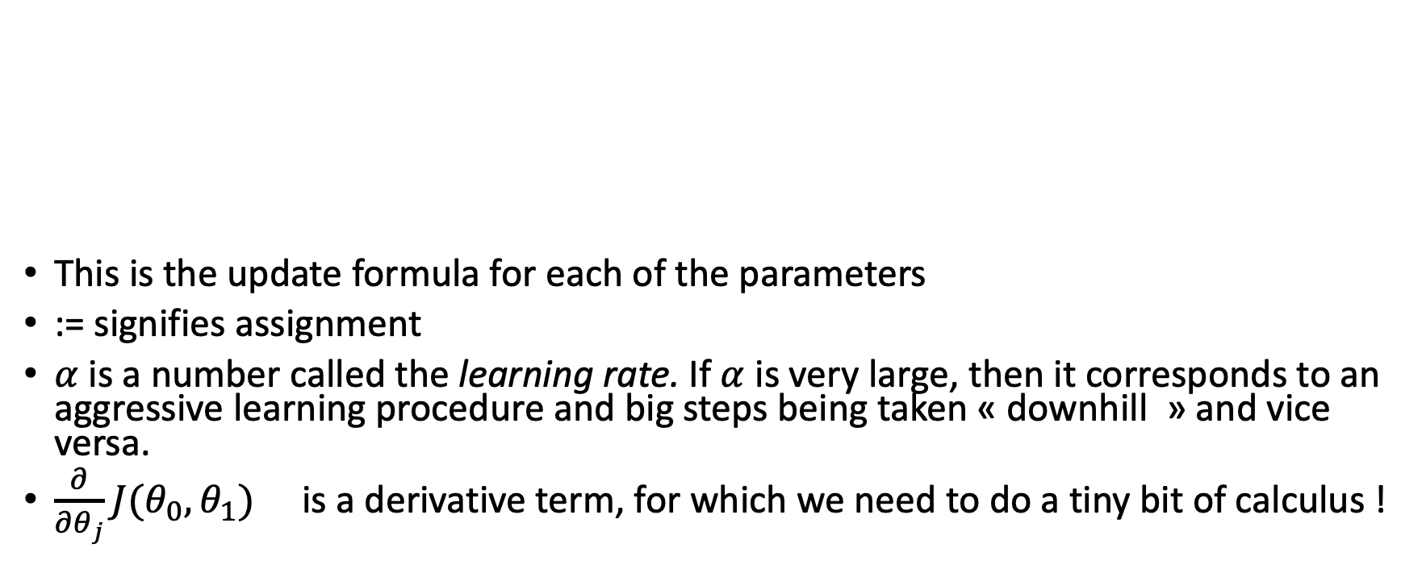
GD formula
This is the update formula for each of the parameters
:= signifies assignment
$α$ is a number called the learning rate. If $α$ is very large, then it corresponds to an aggressive learning procedure and big steps being taken « downhill » and vice versa.
$\frac{∂}{∂θ_{j}}J(θ_{0},θ_{1})$ is a derivative term, for which we need to do a tiny bit of calculus !

Slide 30
GD Intuition
Why does this update make sense ?
Why are we putting those 2 terms together ?
Let’s try and get a basic understanding of derivatives before we go any further.

Slide 31
Derivatives
Disclaimer : This is not necessary for you guys to understand completely, but just so you have an inkiling of where the result comes from, we will go over certain essential points about derivatives.

Slide 32
Derivatives
The derivative describes how the output of a function varies with regard to a very tiny tiny tiny variation in input, to the point where we consider almost/pretty much no variation in input…
How can we describe how the ouput varies if the input is fixed…? We will take a look at this paradox.
But to start, let’s first look at a not so tiny change in input
to familarise ourselves with describing how a function’s output varies with regard to the input.

Slide 33
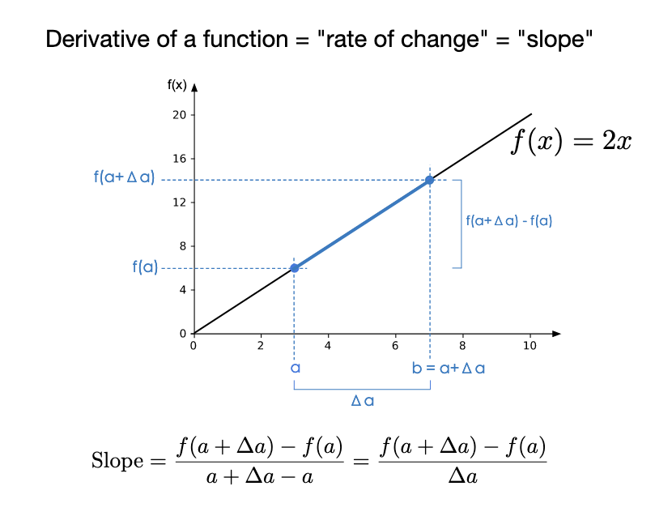
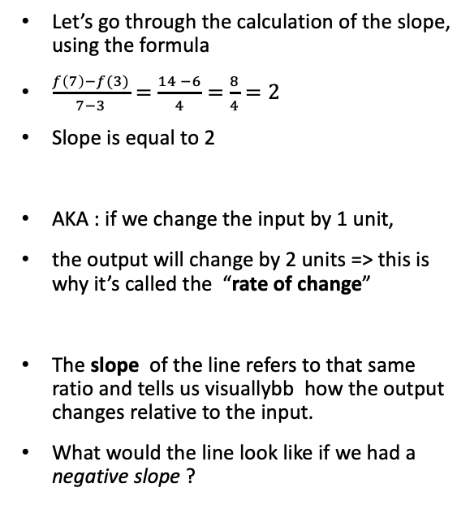
Derivatives
Let’s go through the calculation of the slope, using the formula
$\frac{f\left(7\right)−f(3)}{7−3}=\frac{14 −6}{4}=\frac{8}{4}=2$
Slope is equal to 2
AKA : if we change the input by 1 unit,
the output will change by 2 units => this is why it’s called the “rate of change”
The slope of the line refers to that same ratio and tells us visuallybb how the output changes relative to the input.
What would the line look like if we had a negative slope ?

Slide 34
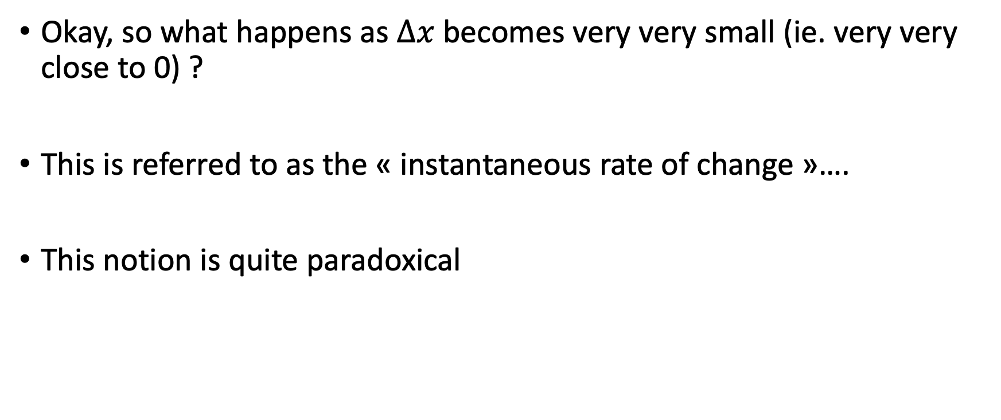
Derivatives
Okay, so what happens as $∆x$ becomes very very small (ie. very very close to 0) ?
This is referred to as the « instantaneous rate of change »….
This notion is quite paradoxical

Slide 35
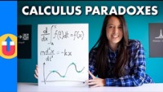
Derivatives : Paradox
Zeno’s Nerf Gun (8:46)

Slide 36
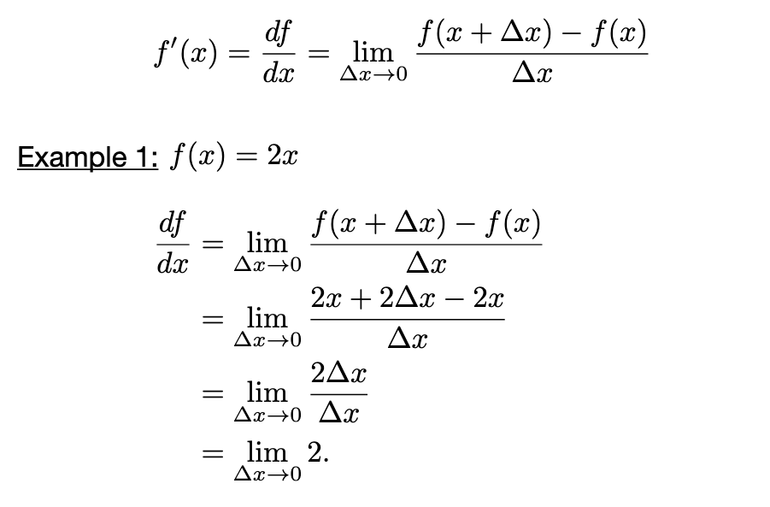
Derivatives : notation and using the limit
So how does a tiny change in x affect the output ?
Lagrange notation
Leibniz Notation

Slide 37
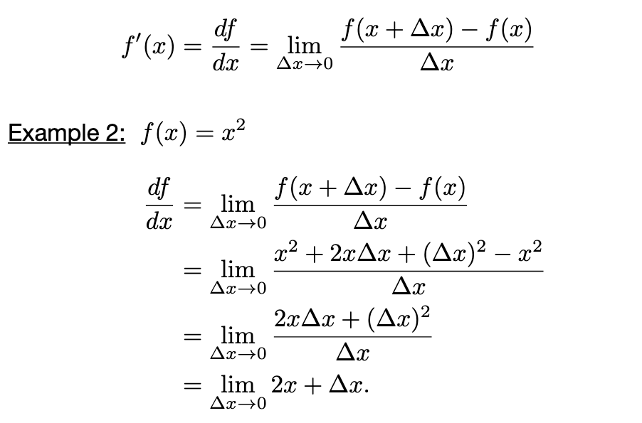
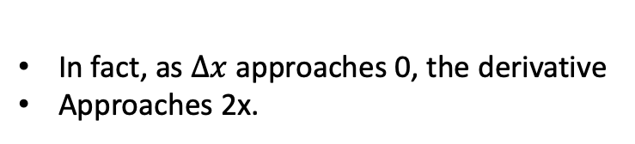
Derivatives: a more elaborate function (optional)
In fact, as $∆x$ approaches 0, the derivative
Approaches 2x.

Slide 38
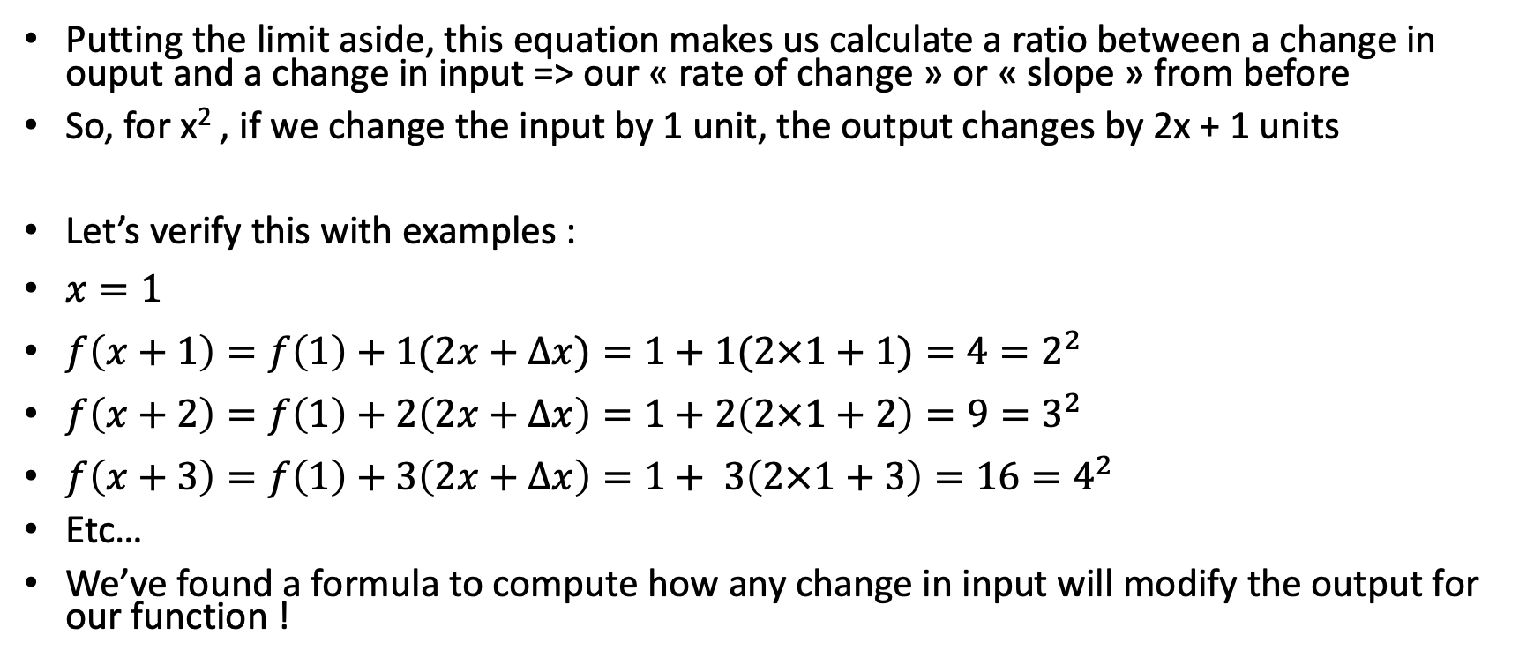
Rate of change (Optional)
Putting the limit aside, this equation makes us calculate a ratio between a change in ouput and a change in input => our « rate of change » or « slope » from before
So, for x² , if we change the input by 1 unit, the output changes by 2x + 1 units
Let’s verify this with examples :
$x=1$
$f\left(x+1\right)=f\left(1\right)+1(2x+∆x)=1+1(2×1+1)=4=2^{2}$
$f\left(x+2\right)=f\left(1\right)+2\left(2x+∆x\right)=1+2\left(2×1+2\right)=9=3^{2}$
$f\left(x+3\right)=f\left(1\right)+3\left(2x+∆x\right)=1+ 3\left(2×1+3\right)=16=4^{2}$
Etc…
We’ve found a formula to compute how any change in input will modify the output for our function !

Slide 39
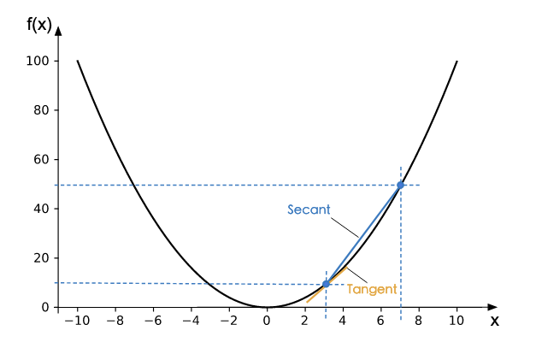
The derivative, visual intuition
As we bring the 2nd point closer on the plotted function, that secant line gets closer and closer to the line tangent to our point in x = 3
The slope of this tangent line is our derivative, our « instantaneous rate of change » !

Slide 40
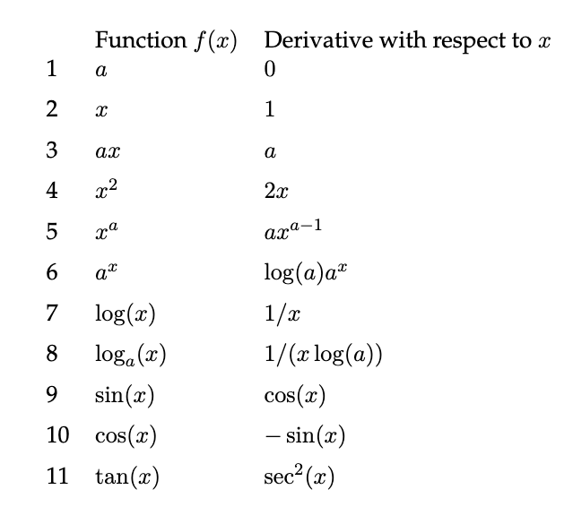
Derivative rules 1 (Optional)
Just so you are aware, no need to learn these by heart. But useful if you want to try and derive a function on your own !
You can find these kinds of « cheatsheets » online if you need to.

Slide 41
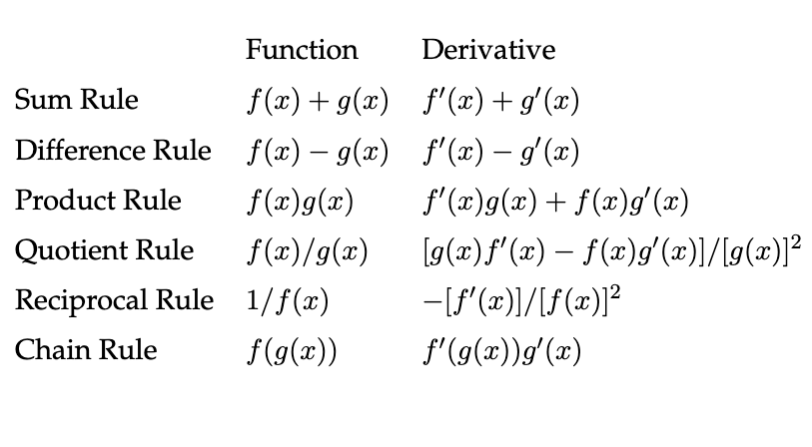
Derivative rules 2(optional)
More useful rules

Slide 42

Quick but useful example using the rules (optional)
$f\left(a\right)=\frac{{\left(ax −y\right)}^{2}}{2} (x and y are constants)$
Power rule : $x^{2}⇒2x$ (the one we saw earlier remember !)
Scalar multiplication rule: $ax⇒a$ (we also saw this earlier !)
Chain rule: $\frac{d}{dx}f\left(g\left(x\right)\right)⇒\frac{df}{dg}×\frac{dg}{dx}$

Slide 43

(Optional)
$f\left(a\right)=\frac{{\left(ax −y\right)}^{2}}{2}$
Let’s decompose this into 3 functions:
$g\left(a\right)=ax −y$
$h\left(X\right)=X^{2} where X takes the place of (ax−y)$
$i\left(Z\right)=\frac{Z}{2} where Z takes the place of{\left(ax−y\right)}^{2}$
Let’s derive these functions 1 by 1 using the rules in the previous slides.

Slide 44

(Optional)
$g^{′}\left(a\right)=\frac{d}{da}(ax−y)=x$
$h^{′}(X)=\frac{d}{dX}\left(X^{2}\right)= 2X$
$i^{′}(Z)=\frac{d}{dZ}\left(\frac{1}{2}Z\right)=\frac{1}{2}$
Using the chaine rule, we multiply these dervatives to get the derivative of our original function :
$$f^{′}\left(a\right)=\frac{di}{dZ}×\frac{dh}{dX}×\frac{dg}{dx}$$
$=\frac{1}{2} × 2\left(ax−y\right) × x$
$=\left(ax −y\right) × x$

Slide 45

GD Intuition
Now we have a basic understanding of derivatives, let’s apply this understanding by using a simpler example, whith a cost function of only 1 single parameter.
We use $J\left(θ_{1}\right)$ instead of $J\left(θ_{0}, θ_{1}\right)$
We are doing the same as previously, when we wanted some intuition about the cost function.
Let’s look at a couple scenarios to see how Gradient Descent updates our parameter $θ_{1}$.

Slide 46


When the derivative is positive…
Remember, our cost function looks like a parabola.
When $θ_{1}$is too high, we would want Gradient Descent to reduce it and bring it closer to the « sweet spot », where the cost is minimized.
Let’s see if it does the right thing :
See Andrew Ng’s course

Slide 47


When the derivative is negative…
When $θ_{1}$is too low, let’s see if Gradient Descent increases it and brings it closer to the « sweet spot », where tht cost is minimized :

Slide 48

Recap
When the the parameter value is too high, the derivative is positive and the update rule decreases the value for the parameter.
$$θ_{1}≔θ_{1}−α\frac{d}{dθ_{1}}J(θ_{1})$$
Conversely, when the parameter value is too low, the parameter value will be increased by the update rule.
$$θ_{1}≔θ_{1}−α\frac{d}{dθ_{1}}J(θ_{1})$$

Slide 49


Okay so now what about ⍺ ?
Remember the update rule : $θ_{1}≔θ_{1}−α\frac{d}{dθ_{1}}J(θ_{1})$
How does ⍺ influence how we update our parameter $θ_{1}$?
If ⍺ is too small :

Slide 50

If too alpha too small
Many small steps will be taken , which maks Gradient Descent very slow

Slide 51
If ⍺ too large…
Gradient descent may « overshoot », go past the minimum. It may even never converge (never find the minimum) and keep jumping around.

Slide 52

If alpha too large

Slide 53


Question
Leave $θ_{1}$unchanged ?
Change $θ_{1}$ in a random direction ?
Move $θ_{1}$ in the direction of the global minimum of ${J(θ}_{1}) ?$
Decrease $θ_{1}$ ?

Slide 54

Piecing everything together
You now have an intuition of what the algorithm is doing, so let’s go through the update together
This is all we need :
A hypothesis function (our model)
A cost function (to tell us how well/bad our model is doing)
Gradient Descent (to update our parameters and get closer to a better model)

Slide 55

Derivatives vs. Partial derivatives
Instead of having a cost function with a single input, we are back to 2 inputs, our 2 parameters $θ_{0}$and $θ_{1}$.
This means that to know the function’s « rate of change », we now have to look at how a tiny change in each parameter affect’s the function’s output.
How does a tiny change in $θ_{0}$change $J\left(θ_{0}, θ_{1}\right)$ ?
How does a tiny change in $θ_{1}$change $J\left(θ_{0}, θ_{1}\right)$ ?
We need to compute what are called the partial derivatives of the cost function.

Slide 56

Derivatives vs. Partial derivatives
Partial Derivative :
This comes down to calculating the derivative for each variable, treating the other variables as constants, or fixed values.
when looking at $θ_{0}$ , we treat $θ_{1}$ as a constant, a fixed value (pick any number you want)
when looking at $θ_{1}$ , we treat $θ_{0}$ as a constant, a fixed value (pick any number you want)

Slide 57

Partial derivatives and graphs intuition
The partial derivative is sometimes referred to as the slope of a slice of a 3D graph. To help illustrate things and relate them to our simple Gradient Descent intuition:

Slide 58

Update rule
So we need to figure out the partial derivatives for each parameter,
In other words, how much does a small change in input for each parameter (at the chosen parameter value) nudge the output ?
We then obtain
the partial derivative of $J\left(θ_{0},θ_{1}\right)$with respect to $θ_{1}$
the partial derivative of $J\left(θ_{0},θ_{1}\right)$ with respect to $θ_{2}$

Slide 59


Partial derivatives of $J\left(θ_{1},θ_{2}\right)$
You can treat these results as being given, in order not to go into the details of the derivation, which involves a couple of the rules mentioned in the optional slides
General formula
$$\frac{∂}{∂θ_{j}}J\left(θ_{0},θ_{1}\right)=\frac{∂}{∂θ_{j}} \frac{1}{2m} \sum_{i=1}^{m}{{\left(h_{θ}\left(x^{i}\right)−y^{i}\right)}^{2} }$$
$$\frac{∂}{∂θ_{j}}J\left(θ_{0},θ_{1}\right)=\frac{∂}{∂θ_{j}} \frac{1}{2m} \sum_{i=1}^{m}{{\left(θ_{0}+θ_{1}x^{i}−y^{i}\right)}^{2} }$$

Slide 60

Partial derivatives of $J\left(θ_{1},θ_{2}\right)$
Here are the partial derivatives obtained (take these at face value for now):
$$j=0 : \frac{∂}{∂θ_{0}}J\left(θ_{0},θ_{1}\right)=\frac{1}{m}\sum_{i=1}^{m}{(h_{θ}(x^{i}}) −y^{i}\text{)}$$
$j=1 : \frac{∂}{∂θ_{1}}J\left(θ_{0},θ_{1}\right)=\frac{1}{m}\sum_{i=1}^{m}{(h_{θ}(x^{i}}) −y^{i}\text{)}x^{i}$
These formulas allow us to compute the partial derivatives for each of the parameters.

Slide 61


Gradient Descent
We now have formulas to update our parameters !
These must be updated simultaneously
Not 1 after the other, as the result of updating $θ_{0}$ will impact the update of $θ_{1}…$

Slide 62

Quick recap to put things into perspective
We have :
a model, which is a line :
$$h\left(x\right)=θ_{0}+θ_{1}x$$
a cost function, to tell us how good/bad our model is fitting the data:
$J\left(θ_{0}\text{,}θ_{1}\right)=\frac{1}{2m}\sum_{i=1}^{m}{{(h\left(x^{(i)}\right)−y^{(i)})}^{2}}$
Gradient Descent, a method to update our parameters so as to minimize the cost function:
$$θ_{j}≔θ_{j}−α\frac{∂}{∂θ_{j}}J(θ_{0},θ_{1})$$

Slide 63

Update examples
For linear regression, the cost function will always be bowl-shaped

Slide 64

Update examples
Say we initialize our parameters randomly, this is the model and cost :

Slide 65

Update examples
As we take Gradient Descent steps, the model (line) seems to be fitting the data better

Slide 66

Update examples
Until we reach the global minimum

Slide 67
What if we have several features vs. only 1 ?

